Slide 1
WELCOME TO 2024
Parent Information
Stage 2

Slide 3
Aims
Meet Stage 2 staff
Provide information about Key Learning Areas and specific details involving Stage 2
If you need to make an interview with your child's teacher, please contact the school to make a mutually convenient time

Slide 4
Our Team
Stage 2
3D- Baillie Drew
3F- Megan Faunce
4E- Wayne Edwards
4S- Chris Spencer
3/4D – Louise Duck (Assistant Principal)
Geography/History – Craig Blanch
Music – Carolyn Coleman (Semester 1)
Science/Tech- Donna Ayton and Shannon Metti

Slide 5
Communication – Messages
In response to parent feedback, from Term 1 - Week 4 classroom teachers will trial using Messages in the Sentral for Parents Portal app. Messages acts as a direct line of communication between parents/caregivers and teachers to support students without the need to send emails via the school email address. Parents will only be able to send messages to the staff designated as ‘Teachers’ of their children’s classes.
Teachers will check Messages daily through Sentral before 8:30am Monday to Friday and respond at their earliest convenience. If the class teacher is absent, a reply might not be received until they return to school.
Understand that class teachers cannot respond to messages while they are teaching and therefore will not respond immediately to messages.
Communication of negative incidents and other concerns should be communicated via a phone call, face-to-face meeting or current planning room procedures.
5

Slide 6
Communication – Messages
Parents are still required to contact the office for any urgent messages, e.g. same day change in pick up arrangements. This will ensure that urgent messages reach students in time. If the message cannot wait 24 hours, call the office.
General school related enquires should be made to the office.
Whole school, grade or whole class notifications sent from the school will be posted within the newsfeed section of the portal and a reply cannot be sent.
Examples of appropriate messages
Examples of inappropriate messages
A parent:
Making a request for a phone call or face-to-face meeting to discuss their child's progress or an incident
Sending an RSVP for a PBL Values assembly
Lost property
A parent:
Advising of same day change in pick up arrangement
Discussing details of a negative incident
6

Slide 7
PBL and Stellars
House families are aimed at developing a sense of belonging– twice a term
Positive reward system - Stellars for displaying our 3 values – Respect, Responsibility & Personal Best
Rewards Day activities- every term
PBL Values awards are given out to 2 students twice a term in the Friday assembly.

Slide 8
Behaviour Management
Whole School Approach- Peg System- classroom warnings
Incident Reports
Communication with students
Planning room – is all about restitution. Parents will be notified either by letter or a phone call that their child will be attending/or has attended planning room. It's a discussion about making positive choices.

Slide 9
Communication
Class teachers are available to meet with parents/carers to discuss student progress or any concerns you may have.
Parent/Teacher interviews are scheduled in weeks 10/11 of this term.
If there is a problem, don’t delay. Problems can escalate if not attended to immediately.

Slide 11
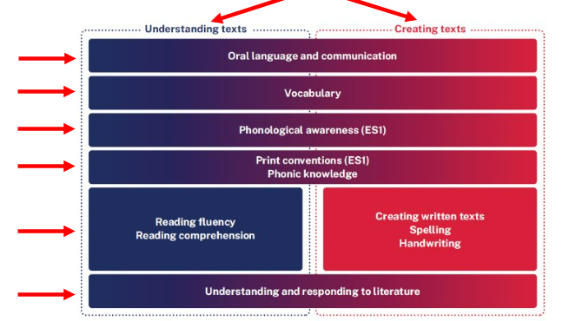
English
Curriculum reform
All outcomes for English 3-6 fall under 2 key processes.

Slide 12
English
Our unit in Term 1 is a Narrative unit based on Fantastic Mr Fox.
This unit will illustrate the
importance of learning about
and enjoying literature through
the study of quality texts.
Terms 2 –4 units TBA (will be based
on students' areas of identified need).

Slide 13
Mathematics
Mathematics is divided into 3 categories:
Number and Algebra
Measurement and Space
Statistics and Probability
The working mathematically processes such as communicating, reasoning and problem solving are embedded in the outcomes and content we teach.

Slide 14
Mathematics
Our daily program consists of:
Warm Up
Daily number sense
Lesson (differentiation)
Reflection

Slide 15
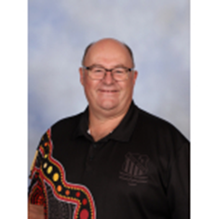
Geography/History
Craig Blanch
Welcome everyone!
I’m all for an inclusive school program and
enjoy helping all my students as they strive
towards their goals.
I have been teaching for 36 years across
all stages.
I am excited to be teaching Geography and History this year!

Slide 16
Geography/History
Geography-Semester 1: The Earth’s Environment
Bushfire hazards in Australia
Students explore the impact bushfires have on Australian people, places and environments and propose ways they can reduce the impact of bushfires in the future.
Great Australian landmarks
Students investigate distinctive and well-known features of the Australian environment to determine why they became national landmarks. They complete a research activity on their choice of national landmark.
History-Semester 2: Community and Remembrance
Moving from the heritage of their local area, students explore the historical features and diversity of their community. They examine local, state and national symbols and emblems of significance, and celebrations and commemorations both locally and internationally.

Slide 17
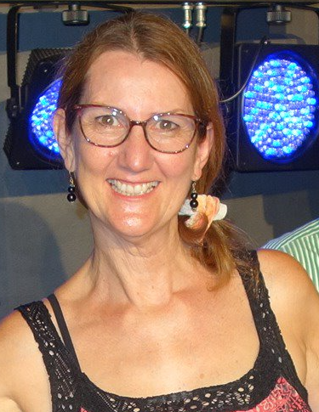
Music/Drama
Carolyn Irvin
· Jazz and blues pianist and vocalist -has been performing professionally for many years.
· Passionate about the arts and creative thinking in education.
· Tirelessly promotes music programs at ABPS such as: Choirs, String Groups and Band.
· Encourages skill-based opportunity for learning where every child plays an instrument such as keyboard, ukulele, guitar and percussion in the Music RFF time slot .
· Promotes improvisation in drama and composition in music lessons to encourage creativity, engagement and confidence.
· Teaches Stage 2 and 3 Music and Drama to each class for 1 hour per week for one semester (Terms 1 and 2)

Slide 18
Music
Music is part of the RFF program.
*Band - Senior band will start next Wednesday 14 Feb
Training Band will begin next Term 2 notes will be sent out end of T1
*Strings –Seniors meet Monday and Friday 8:00am – 9:00am. Will perform at the Opera House for The Festival of Instrumental Music
Intermediates- meet in the hall Wednesdays 8:00am – 9:00am
*Choir- Seniors: Year 3-6 meet Tuesdays 8:30- 9:00am

Slide 19
Science
Semester 1:
Physical World-Energy
Term 1 focuses on light, heat and electrical energy. Students will explore how energy makes things happen and ways that electrical energy can be generated sustainably.
In term 2 students will investigate contact and non-contact forces (such as push and pull) and how these forces can affect the motion of an object.
Semester 2:
Earth and Space-The Earth and Sun
Term 3 will focus on how the Earth's surface changes over time as well as the Earth's relationship with the Sun.
Term 4 focuses on building student's technology skills as well as engaging in hands-on STEM tasks.

Slide 20
STEM
All Science units have been written to embed the STEM (Science, Technology, Engineering and Mathematics) Process.
The STEM Process will guide students throughout the whole year as they engage in hands-on investigations, encouraging critical thinking, problem-solving and collaboration. Students will have access and use of the purpose-built STEM room during their weekly lessons.

Slide 21
Technology
Technology will be embedded into all Science units throughout Terms 1, 2 and 3. Term 4 will then focus on building on students' digital technology skills.
Classroom:
All classes use Google Classroom and create learning tasks to improve student digital literacy
Student Acceptable Use Agreement – outlines safe and responsible online behaviour and care and management of school devices.

Slide 22
PD/H/PE
Fitness/ PE – in class and as a stage each Wednesday
Stage Sport - Friday 1-2pm: Fundamental movement skills and modified PSSA sports.
PD/H - Road Safety / Cyber Safety
- Anti Bullying/Friendology
- Child Protection – Mandatory

Slide 23
Sport
Swimming Carnival – T1: Monday, 4th March at Peninsula Leisure Centre, Woy Woy
Cross Country – Term 2
Athletics Carnival – Term 3
Participation!

Slide 24
Homework
Begins in week 6 and will be project-based assignments to be completed over multiple weeks
Google Classroom/ hard copy available
Library – borrowing at a scheduled time with the classroom teacher and opportunities to borrow during lunchtimes.

Slide 25
Excursions
Year 4 overnight excursion
Broken Bay Sport and Recreation
Term 3 (15/16 August)
Performances for the school musical will take place in late Term 3

Slide 26
NAPLAN/ CHECK INS
NAPLAN Coordinated Practice T1 (Year 3)
Test Window 13-25 March (T1 Weeks 7-9)
CHECK-INS: Years 3 and 4 (T3 Weeks 6-9)

Slide 27
General Information
Please ensure correct uniforms are worn with all belongings labelled with names
The S2 newsletter was sent home last week outlining requirements for school, eg, whiteboard markers and rubbers, glue sticks, coloured pencils and textas, etc.

Slide 28
QUESTIONS

