Slide 1
Parent Information Session
Stage 2 2023

Slide 2
Acknowledgement of Country
On behalf of the DoE, we would like to pay our respect and acknowledge the traditional custodians of the land on which this meeting takes place. We would like to pay respect to Elders past and present and extend that respect to any Aboriginal people who may be present today.​
‹#›

Slide 3
Stage 2 Team
Principal - Ben Thomas
AP - Early Stage 1 - Nikki Tobin
AP - Stage 1 - Esther Hartley
AP - Stage 3 - Louise Duck
APC&I / AP Stage 1 - Jodie Ward
2023
Roxanne Davies - 4D
Assistant Principal
Megan Faunce - 3F
Angus McBride (Friday)
Dennis Jarmaine - 3J
Chris Spencer - 3/4S

Slide 4
Strategic Improvement Plan 2021-2025
Strategic Direction 1
To improve student learning outcomes in reading and numeracy, we will examine quality data which will lead to targeted instructional leadership and implementation of explicit instruction in every classroom.
Strategic Direction 2
To increase the proportion of students reporting sense of belonging at school.
Strategic Direction 3
To improve quality systems across the school to support to support professional effectiveness of all school members.

Slide 7
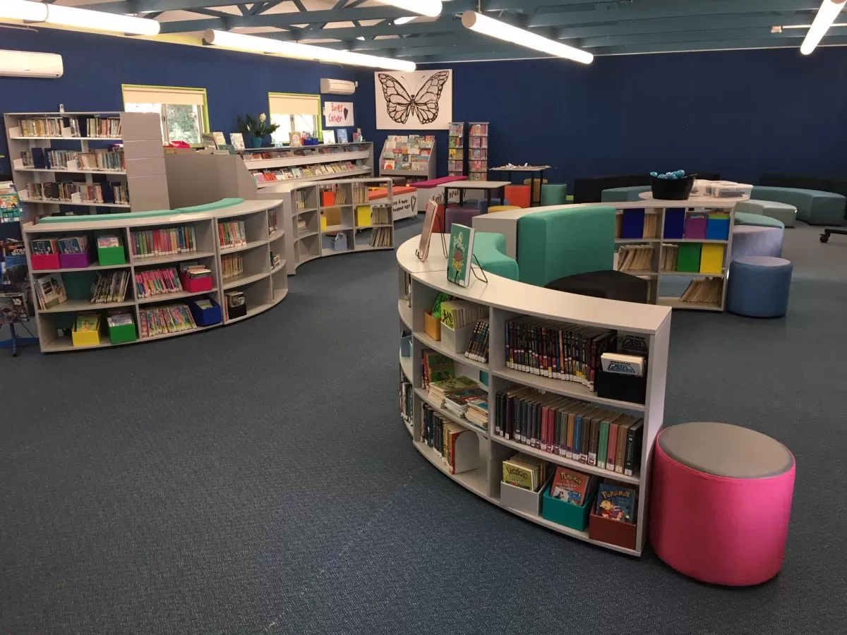
Communication
Please ensure the office has your correct contact details.​
Sources of information: School fortnightly newsletter, notes, school app, school sign, website and most importantly your child's classroom teacher.​
Parent / Teacher /Student Interviews will be available at the end of Term 1.
Homework
Homework will commence Term 1 Week 4.
It is designed to reinforce the basics. Spelling, multiplication facts and reading.
It will be handed out on Monday and due on Friday.
Library Borrowing
The library is open first half of lunch on Monday - Thursday for borrowing.
Once a fortnight - class borrowing. Each student is able to borrow up to four books.
‹#›

Slide 8
PBL - Positive Behaviour for Learning
Stellars are given out in the classroom and playground to students for displaying our 3 values – Respect, Responsibility & Personal Best. ​
Rewards Day activities are suggested by students and occur at the end of each term.
Certificates are awarded when students reach 25 Stellars - Class / Playground.
PBL Values awards will be given out to 2 students twice a term at the Friday assembly. ​Parents/carers are invited to the assembly.
Managing Challenging Behaviours
Peg system - 2 warnings to modify behaviour. Third redirection leads to a time out.
Parents/ carers will be notified and asked to return the letter
New day - New start
House Families - Belonging
Friday - 12:20 - 1:20
Sessions designed to develop a sense of belonging K-6
‹#›

Slide 9
General Information
Year 4 Camp – Broken Bay Sport and Recreation Centre
Thursday 3rd and Friday 4th August
Located one hour north of Sydney on the Hawkesbury River and is accessible by boat. It is nestled on 650 hectares of unspoilt bushland between isolated headlands and the beach, with spectacular views of the iconic Barrenjoey Lighthouse, Lion Island and rugged sandstone cliffs lining the River.
Activities include height, aquatic, nature-based, recreation and interpersonal and movement activities.
‹#›

Slide 10
English
Writing
Theme: Adventure
7 Steps Writing Program
1. Plan for success
2. Sizzling starts
3. Tightening tension
4. Dynamic Dialogue
5. Show, Don’t Tell
6. Ban the Boring
7. Exciting Endings
We will be covering all types of text (imaginative, persuasive and informative) multiple times over the course of the the year.
‹#›

Slide 11
Spelling
Weekly lists are made up of high frequency words, phonological words and the rule for the week. Pre-test each week and spelling lists are differentiated.
Reading
Literacy Pro Year 3-6, fluid and flexible literacy groups focusing on comprehension skills, fluency etc.
Literacy Groups
Students will participate in literacy rich experiences. Groups will be fluid (change regularly). These activities will help to consolidate students understanding in writing, reading and spelling.
‹#›

Slide 12
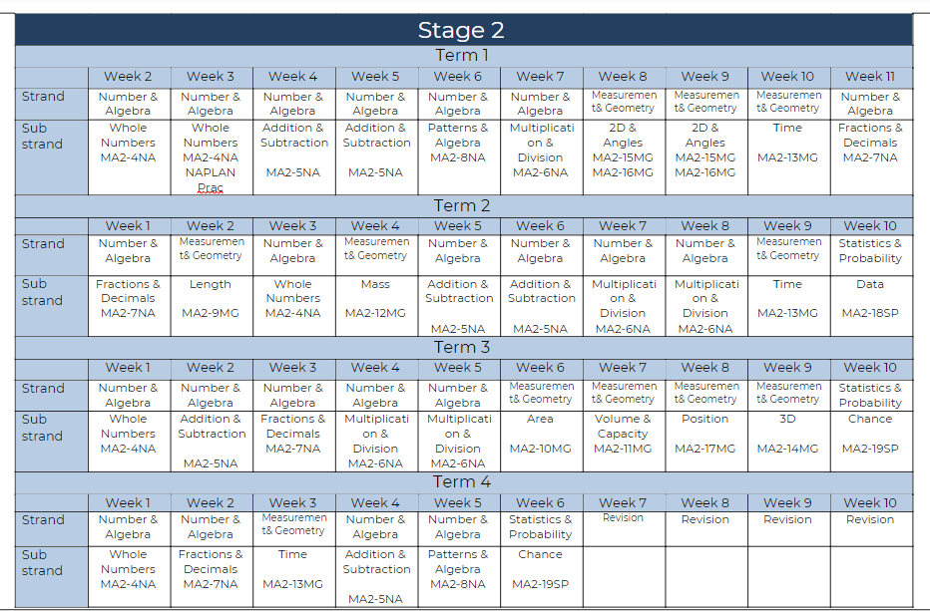
Mathematics
Scope & Sequence
​
​
​
‹#›

Slide 13
Mathematics
Essential Assessment
Used in Stage 2 for pre and post assessments in all sub strands of Mathematics.
Pre assessment data is used to plan differentiated teaching and learning programs
Fully aligned to the K-10 syllabus covering content from ES1 through to Stage 5.3, the national Numeracy and Literacy Progressions and new K-2 English and Mathematics syllabus
My Numeracy - individual level
Mid and end of Term assessments will also be used.
‹#›

Slide 14
Mathematics
Explicit Instruction and structure
​Explicit Instruction warm-ups are delivered daily prior to the start of every Mathematics lesson to consolidate previously taught concept.
The skills of reciting (to learn), recalling (to remember) and applying (to use) are incorporated into the slides.
Content is varied each day to motivate all students in the classroom and The learning intention of the lesson is displayed and explained.
After the daily warm up the whole class task is given based on the sub strand focus (often involving discussion) and differentiated group work (based on the pre-assessment data) is now given. The teacher will work with all groups at certain times, during this period.
Lastly, word problems are embedded into our weekly routine.
‹#›

Slide 15
Science & Technology - Where would we be without bees?
Living World – Semester 1
Stage 2 of the Living World strand focuses on the classification, life cycles and survival of living things.
Students consider the agricultural processes used to grow plants and raise animals.
Students will design and produce a product or system to support the growth of a plant and/or animal.
They will :
investigate the interdependent relationship between humans and bees.
observe and record changes within their environment.
have the opportunity to learn through engaging experiments.
‹#›

Slide 16
STEM Design Process.
All Science units have been written to embed the STEM (Science, Technology, Engineering and Mathematics) Design Process:
1. Define & think
2. Brainstorm
3. Research & plan
4. Develop & make
5. Test & improve
6. Evaluate & share ​
‹#›

Slide 17
History
First Contacts
Semester 1 as RFF with Ms Julie Boarer
First Contacts introduces world history and the movements of peoples. Beginning with the history of Aboriginal and Torres Strait Peoples, students examine European exploration and colonisation in Australia and the world to the early 1800s.
The unit of work will cover the following outcomes:
HT2-3 describes people, events and actions related to world exploration and its effects.
HT2-4 describes and explains effects of British colonisation in Australia.
HT2-5 applies skills of historical inquiry and communication.
‹#›

Slide 18
Geography
Places are Similar and Different
Semester 2 as RFF with Ms Julie Boarer
Students examine the natural and human features of Australia. They explore and compare different climates, demographic characteristics and natural vegetation of places in Australia. They use this information to imagine what it would be like to live in those places.
The unit of work will cover the following outcomes:
GE2-1 – Examines features and characteristic of places and environments
GE2-2 – Describes the ways people, places and environments interact
GE2-4 Acquires and communicates geographical information using geographical tools for inquiry
‹#›

Slide 19
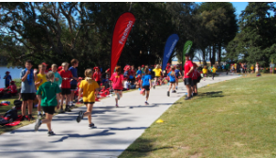
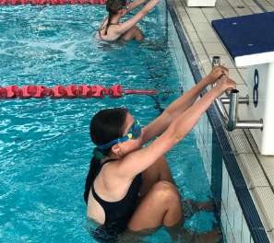
PDHPE/Sport
Sport/PE days: Monday and Thursday. Please ensure your child wears their sports uniform on these days (including a hat).
Modified sports: basketball, cricket, softball, AFL, Touch, dance, soccer, tennis (Hot Shots) and athletics (Term 2).
Skills based (Monday) & game based (Thursday).
Personal Development & Health:
Term 1: Friendology
Term 2: Healthy living/safety
Term 3: Cyber Safety
Term 4: Child Protection - My right to be safe.
Major carnivals:
Swimming: 27th February (Term 1 Week 6)
Cross Country: 28th April (Term 2 Week 1)
Athletics: 19th July (Term 3 Week 1
‹#›

Slide 20
Creative and Practical Arts
Visual Arts
Throughout the year students will create various artworks focussing on skill development. They will investigate and experiment using various, relevant art techniques. This is often based on the units of work we are studying. ​
In Semester 2, students will also make connections between subject matter and appreciate the use of specific techniques and related history within a variety of key art movements.​ (Expressionism, Impressionism, surrealism and cubism).
Music/Drama - Carolyn Irvin (RFF)
During weekly music lessons in Semester 1, students will have the opportunity to learn skills using a variety of musical instruments. They will have access to keyboards, ukuleles, guitars and percussion instruments.
Drama
In drama this semester, students will focus on the voice in dramatic roles using articulation, expression and clarity of intonation and pitch.
Students will develop of improvisation skills.
‹#›

Slide 21
Choir, Band and Strings - Mrs Irvin
Choir
Students in years 3 -6 can join the choir. They meet in the music room every Tuesday morning at 8:45am. This year they have the opportunity to perform in the Central Coast Choral Festival which will culminate in a performance with a combined choir of over 300 students at the Wyong Art House in October.
Band
Senior Band will meet every Wednesday in the FSU room at 8:00am under the guidance of Di Gardiner. Those who wish to join band this year will start in Training band on Tuesdays. Training band will start in Term 2 and a note will be given out in the next few weeks with all the relevant information.
Violin
On Mondays our senior string students meet in the FSU where they are preparing to perform for the Festival of Instrumental Music at the Opera House. Our beginners from last year have now moved up to intermediate but will stay meeting on Fridays at 8:00am. Our new beginning violin students will start next term and a note will be sent home to those students wishing to participate.

Slide 22
Questions?
Thank you for attending

